Slide 1

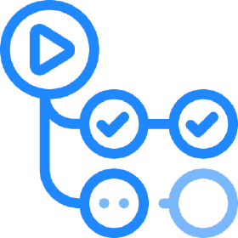
The GitHub Actions Team Si tienes algún problema, y si los conoces, quizas seguro puedan ayudarte
Carlos Mendible
Azure Evangelist @everis
Azure & Developer Technologies MVP
@cmendibl3
Sergio Navarro Pino
Tech Lead @AnalyticAlways
@snavarropino

Slide 2
Goals
Understand what GitHub Actions are
Know its main components and syntax
Create simple CI/CD pipelines
Create a CI/CD pipeline for Kubernetes and Dapr
Create simple actions
Original presentation: https://github.com/dapr/docs/tree/master/presentations
Notes:
QUE QUIERO QUE CONSIGAMOS HOY?

Slide 3
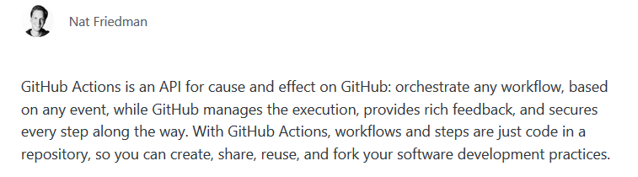
What is?
https://github.com/features/actions
https://github.blog/2019-08-08-github-actions-now-supports-ci-cd/

Slide 4
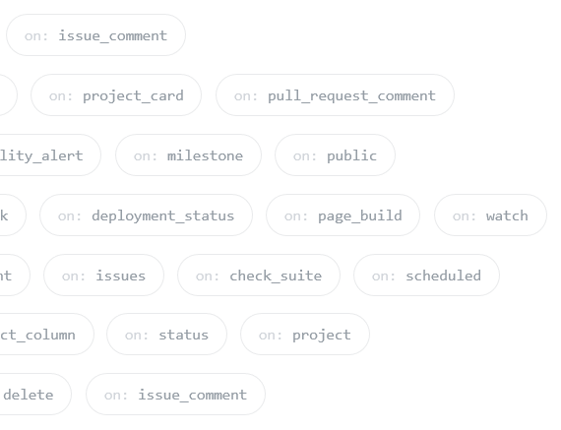
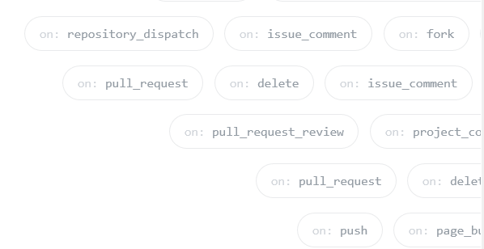
What events?

Slide 5
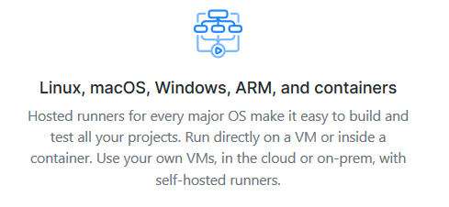
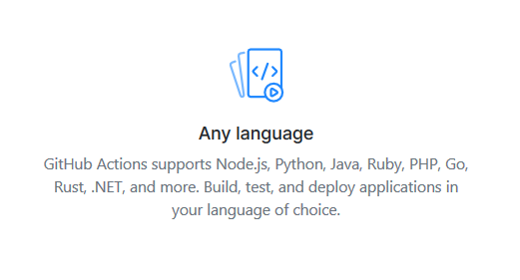
Which languages? How many OS’s?

Slide 6
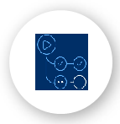
Main components:
Workflows
Events / triggers
Jobs
Steps
https://github.com/snavarropino/the-github-actions-team/actions/new
Actions
Javascript
Docker
https://github.com/marketplace?type=actions
Notes:
Fijaos como nos recuerda en parte a Azure DevOps, aunque veremos más adelante que falta alguna cosa

Slide 7

DEMO!
Notes:
Nos vamos a GitHub, enseñamos que está la sección de Actions y damos a crear un workflow de cero. Lo commiteamos
“Tocamos” el readme y vemos que se ejecuta
Tb vamos a ver el workflow de greetings

Slide 8
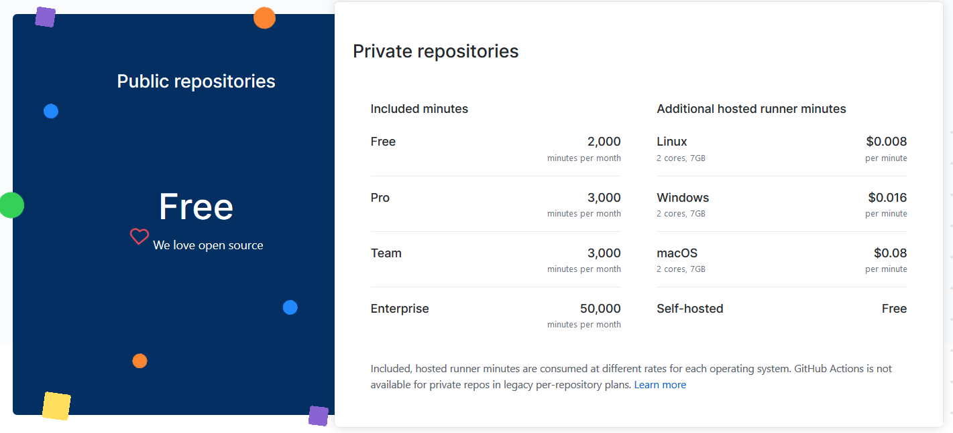
Runners & Billing
GitHub-hosted
https://help.github.com/en/github/setting-up-and-managing-billing-and-payments-on-github/about-billing-for-github-actions

Slide 9
Runners & Billing
Self-hosted
Receive automatic updates for the self-hosted runner application only. You are responsible updating the operating system and all other software.
Can use cloud services or local machines that you already pay for.
Are customizable to your hardware, operating system, software, and security requirements.
Are free to use with GitHub Actions, but you are responsible for the cost of maintaining your runner machines.
https://help.github.com/en/actions/hosting-your-own-runners/about-self-hosted-runners

Slide 10

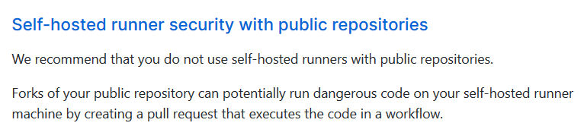
Runners & Billing
Self-hosted

Slide 11
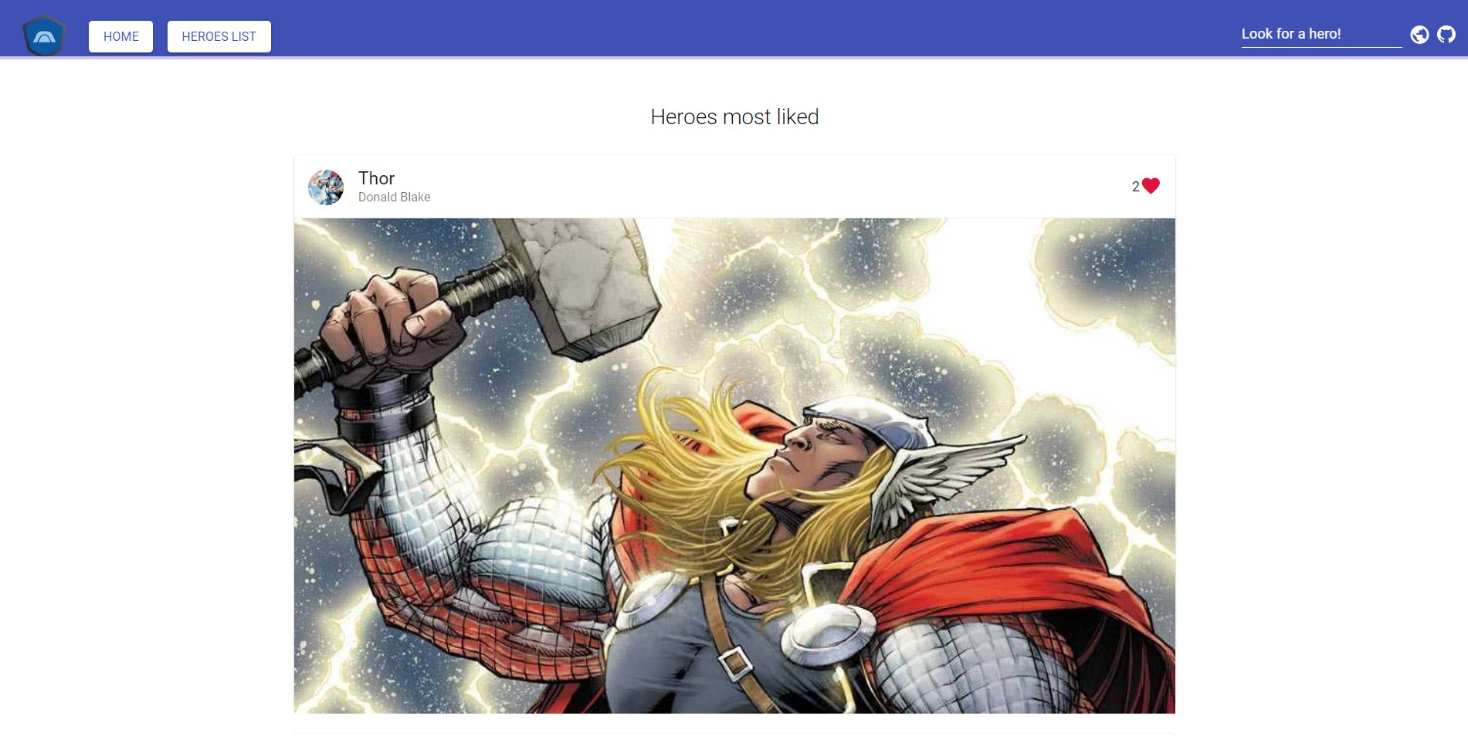
DEMO!
Notes:
Vamos con la aplicación de Heroes, la enseñamos
Mostramos la pipeline de front y la de back
Modificamos algo, commiteamos (desde code) y vemos que se lanzan

Slide 12
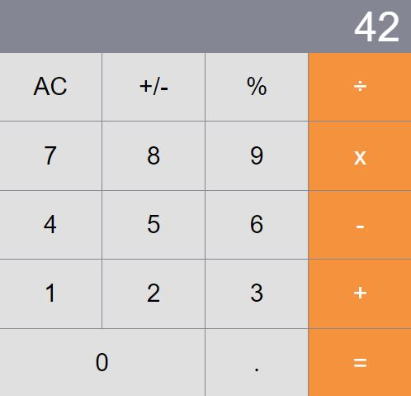
What about microservices?
Notes:
Mostramos la calculadora

Slide 13
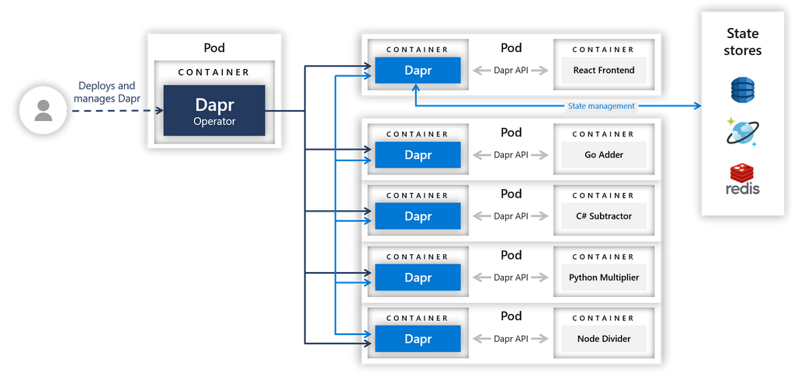
Notes:
Contamos que la aplicación esta hecha con varios microservices

Slide 14
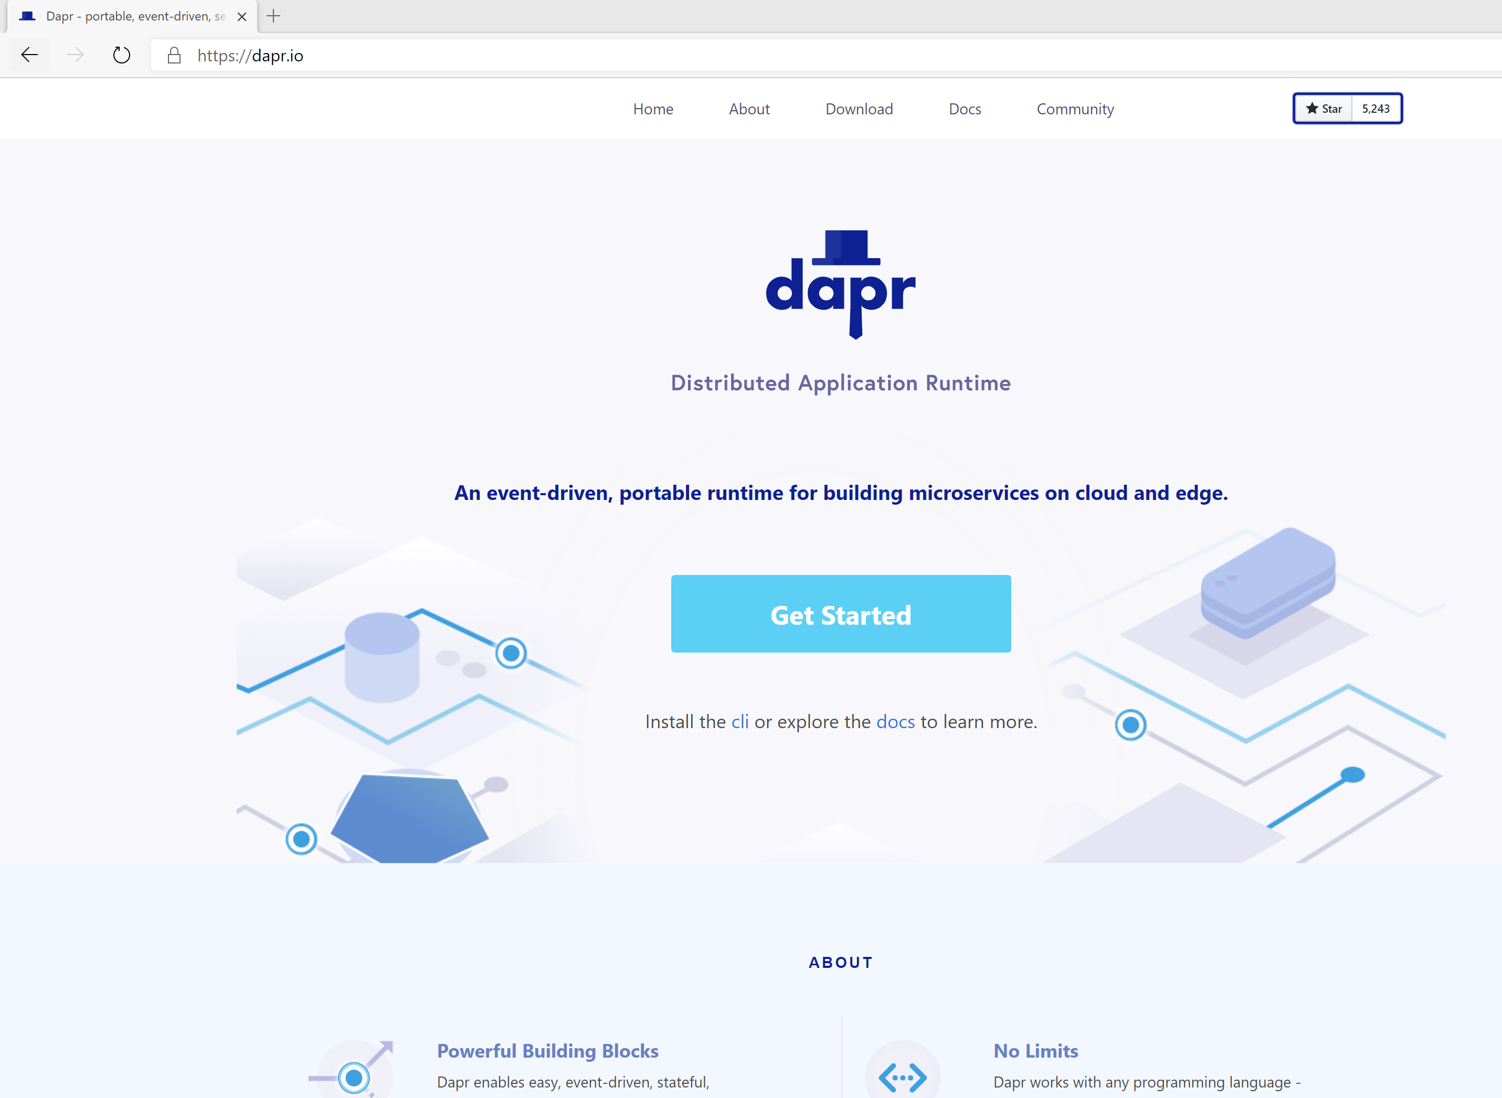

Distributed Application Runtime
Portable, event-driven, runtime for building distributed applications across cloud and edge
https://dapr.io
Notes:
Contamos que es Dapr

Slide 15

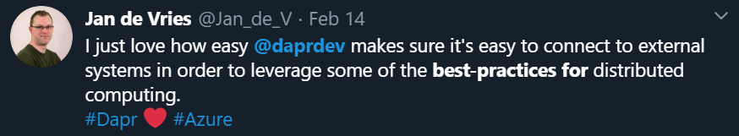
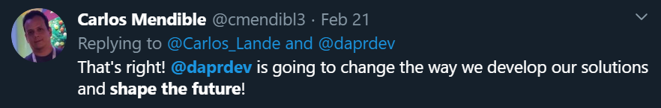
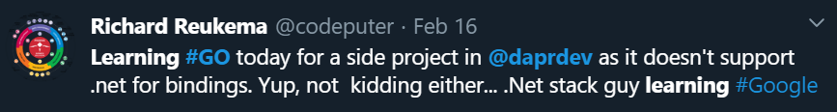
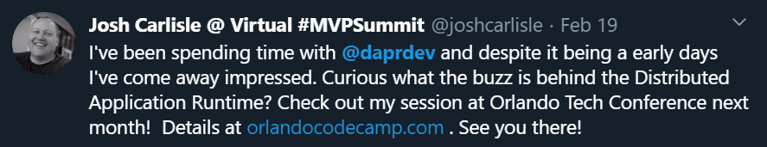
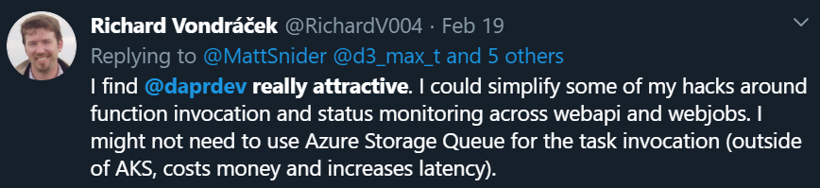
https://github.com/dapr/dapr#community
54 External Contributors
28 new components added since launch
5.7k GitHub stars in under 5 months
Community call every 2 weeks

Slide 16

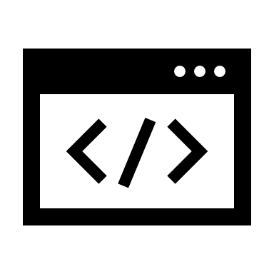





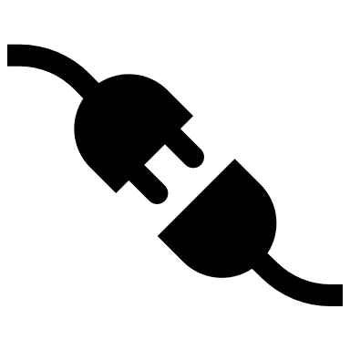
Dapr Goals
Best-Practices
Building Blocks
Any Language
or Framework
Community Driven
Vendor Neutral
Adopt Standards
Consistent, Portable,
Open APIs
Platform Agnostic
Cloud + Edge
Extensible and
Pluggable Components

Slide 17

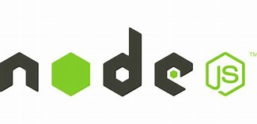


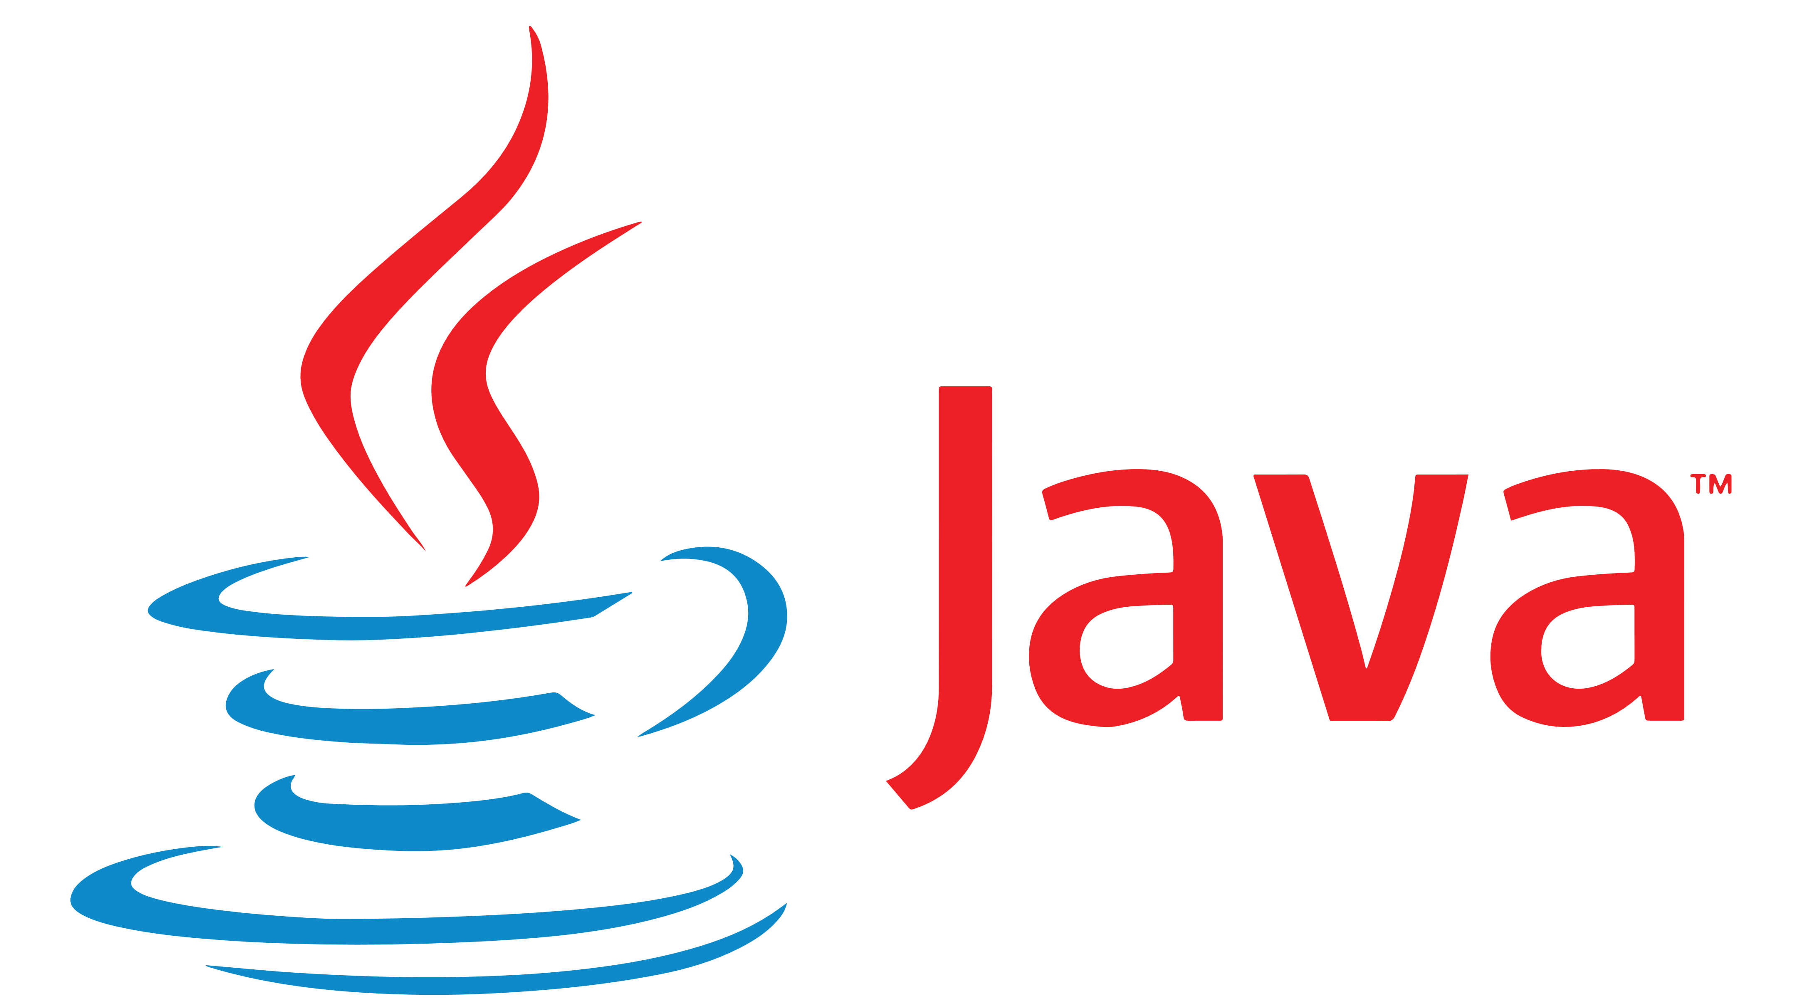
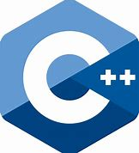
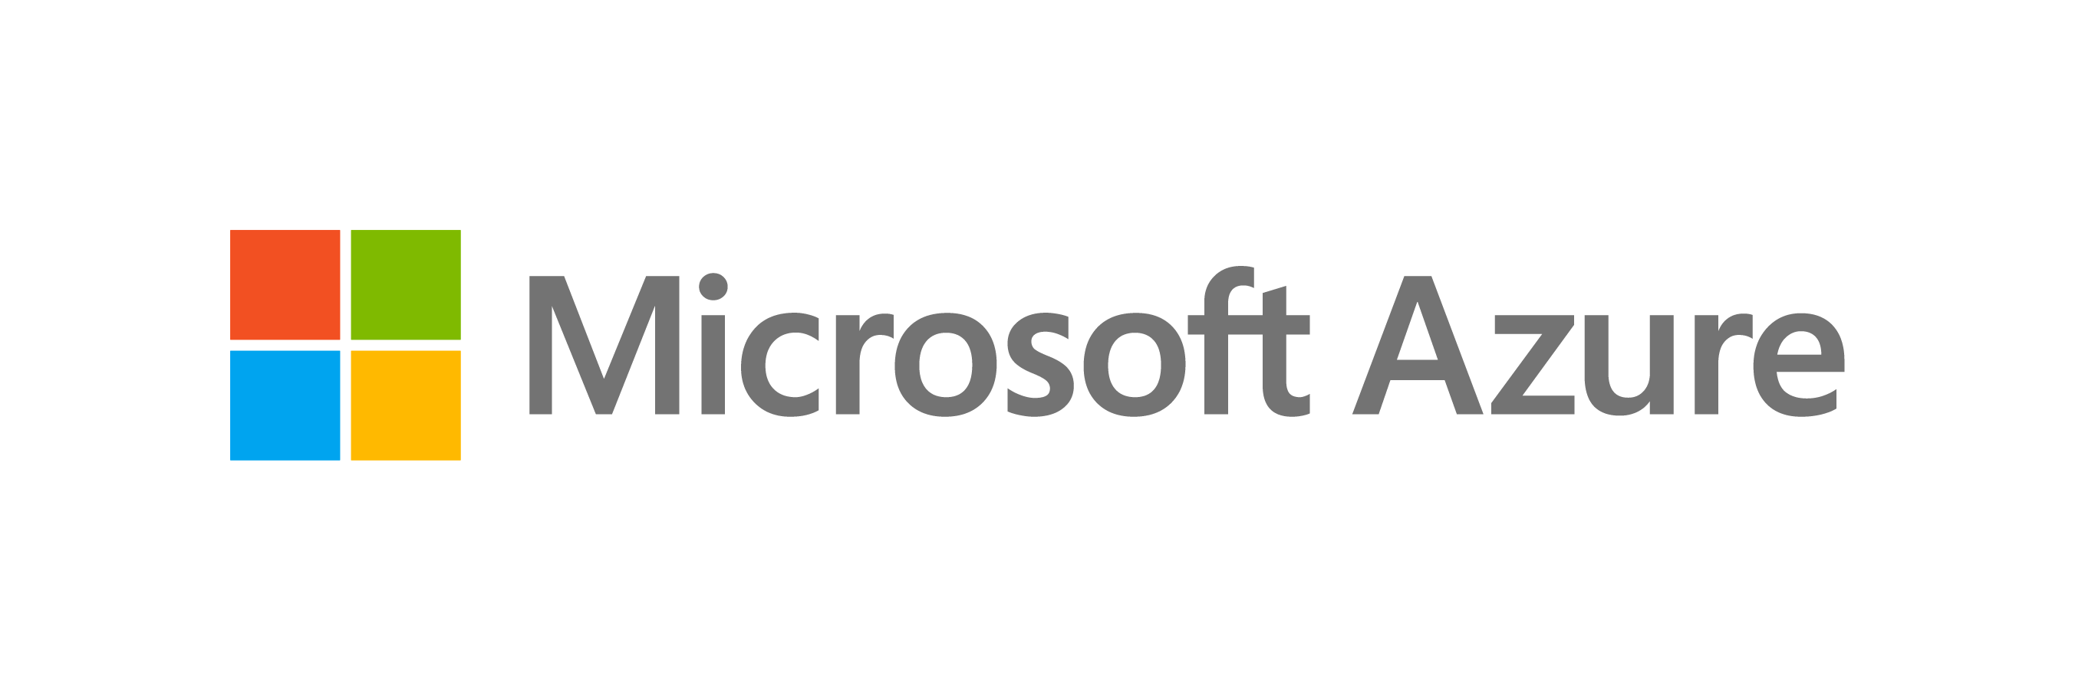

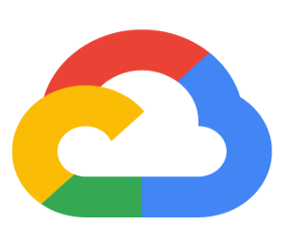




Dapr: Distributed Application Runtime Build apps using any language with any framework
Application code
Microservices written in
Any code or framework…
HTTP API
gRPC API
Service-to- service invocation
State management
Publish and subscribe
Resource bindings and triggers
Actors
Distributed tracing
Secrets
Extensible
Any cloud or edge infrastructure

Slide 18


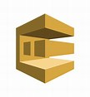

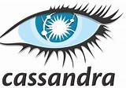


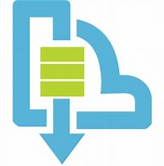




Dapr Kubernetes hosted
Deploys and manages Dapr
1
Components
Updates actor partition placement
Certificate Authority
Update component changes
Resource bindings
Pod
Pod
Pod
Pod
Input/output
CONTAINER
CONTAINER
CONTAINER
CONTAINER
…others
Component management
EventHub
Kafka
AWS SQS
GCP pub/sub
Actor Placement
Sidecar Injector
Sentry
Operator
State stores
Injects Dapr runtime
AWS
DynamoDB
CosmosDB
…others
Pod
CONTAINER
Dapr API
CONTAINER
Publish & subscribe
HTTP or gRPC
…others
Sidecar
Application code
Service Bus
Distributed Tracing
Uses components
Any cloud or edge infrastructure
Prometheus
AppInsightts
Jaeger

Slide 19
Microservice building blocks
Service-to- service invocation
State management
Publish and subscribe
Resource bindings and triggers
Actors
Distributed tracing
Secrets
Perform direct, secure, service-to-service method calls
Create long running, stateless and stateful services
Secure, scalable messaging between services
Trigger code through events from a large array of inputs
Output bindings to external resources including databases and queues
Encapsulate code and data in reusable actor objects as a common microservices design pattern
See and measure the message calls across components and networked services
Securely access secrets from your application
Use Dapr components

Slide 20
Microservice building blocks
Service invocation
Post
http://localhost:3500/v1.0/invoke/cart/method/checkout
{
"user":"johndoe",
"cart":"0001"
}
“frontend”
Post
http://10.0.0.2:8000/checkout
{
"user":"johndoe",
"cart":"0001"
}
“cart”

Slide 21
Microservice building blocks
State management: key/value
Get
http://localhost:3500/v1.0/state/<store-name>/planet
{
"name": "Tatooine"
}
App
“myApp”
key | value
myApp-weapon | "DeathStar"
myApp-planet | { "name": "Tatooine" }
Post
http://localhost:3500/v1.0/state/<store-name>
[{
"key": "weapon",
"value": "DeathStar"
}, {
"key": "planet",
"value": {
"name": "Tatooine"
}
}]
State store of your choice
AWS
DynamoDB
CosmosDB
…others

Slide 22
DEMO!
Notes:
Calculadora
Mostramos workflows, hay uno por app
Mostramos que no funciona la resta bien, tiene un bug
Nos vamos al de C#, lo arreglamos y commiteamos
Vemos q se ejecuta el workflow y voila!

Slide 23
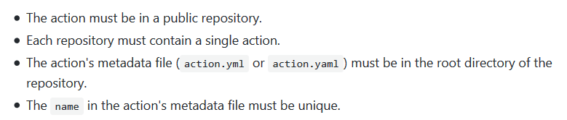
Authoring our own actions
Two flavours:
Docker container
Javascript
Can be published to the marketplace
https://help.github.com/en/actions/building-actions

Slide 24
DEMO!
Notes:
Mostrar una acción docker

Slide 25
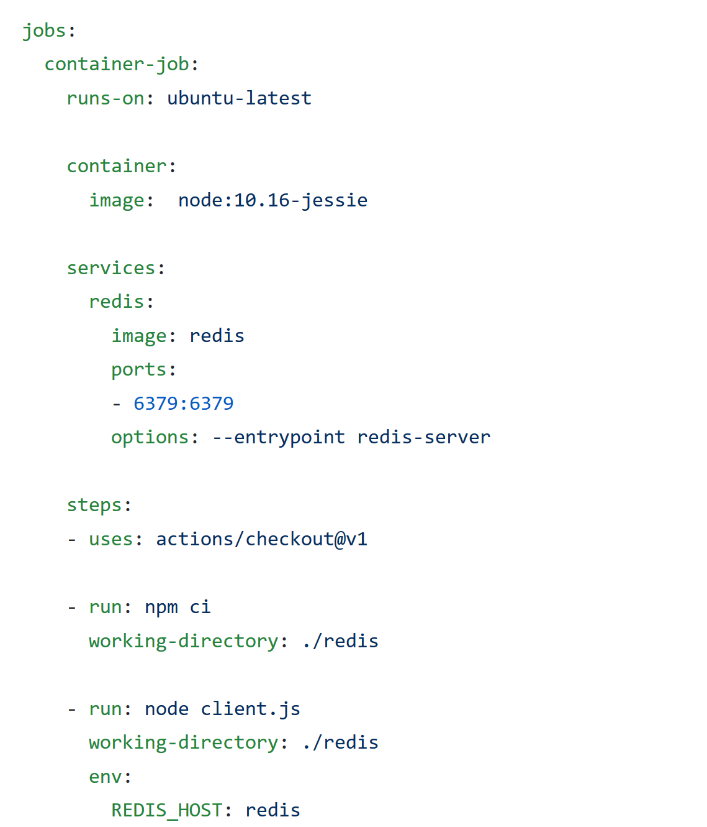
Services

Slide 26

Workflows don’t have to be created by the UI
Clear paths to create actions
Services allow us to easily use dependencies in our workflows
Free for public repositories
Much more than CI/CD

Slide 27

There are no stages, environments or similar
We cannot delete workflows already run
We have no templates

Slide 28
Resources
Repositories with the demos:
https://github.com/snavarropino/the-github-actions-team
https://github.com/snavarropino/hello-github-actions
Other resources:
Dapr: https://dapr.io/
GitHub DevOps learning Path:
https://lab.github.com/githubtraining/paths/devops-with-github-actions
Fernando Escolar’s video comparing to Azure Pipelines: https://youtu.be/H14PuQI1SyE
Gisela Torres blog posts (in Spanish): https://www.returngis.net/
Notes:
Mostrar una acción docker

Slide 29

Notes:
Calculadora
Mostramos workflows, hay uno por app
Mostramos que no funciona la resta bien, tiene un bug
Nos vamos al de C#, lo arreglamos y commiteamos
Vemos q se ejecuta el workflow y voila!

